Slide 1
SOFTWARE
Software is the program that runs on the computer and is used to operate the computer hardware.

Slide 2
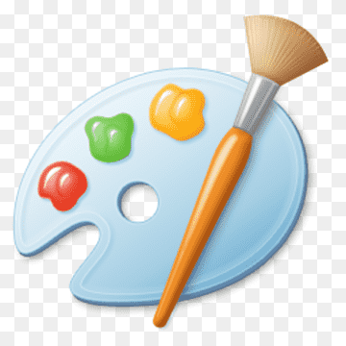
TYPES OF SOFTWARE
PAINT

Slide 3

TYPES OF SOFTWARE
NOTEPAD

Slide 4

TYPES OF SOFTWARE
SKETCHBOOK

Slide 5

TYPES OF SOFTWARE
CALENDER

Slide 6

TYPES OF SOFTWARE
MUSIC PLAYER

